Slide 1
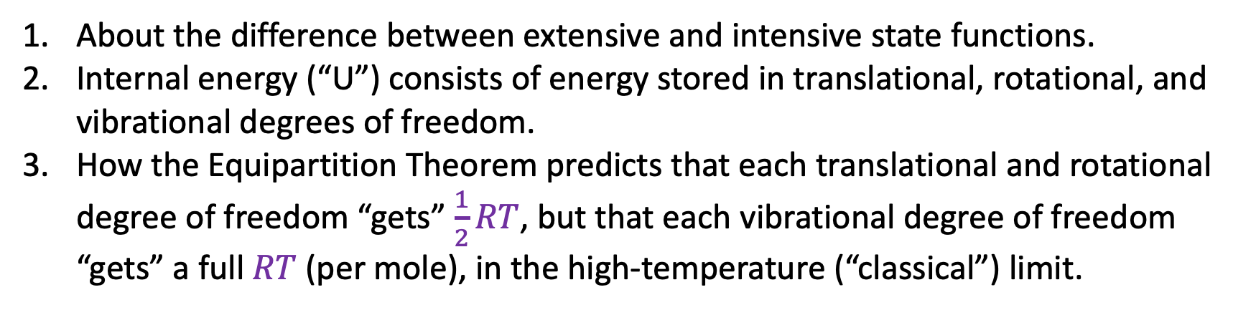
Summary of where we left off last time
About the difference between extensive and intensive state functions.
Internal energy (“U”) consists of energy stored in translational, rotational, and vibrational degrees of freedom.
How the Equipartition Theorem predicts that each translational and rotational degree of freedom “gets” $\frac{1}{2}RT$, but that each vibrational degree of freedom “gets” a full $RT$ (per mole), in the high-temperature (“classical”) limit.

Slide 2
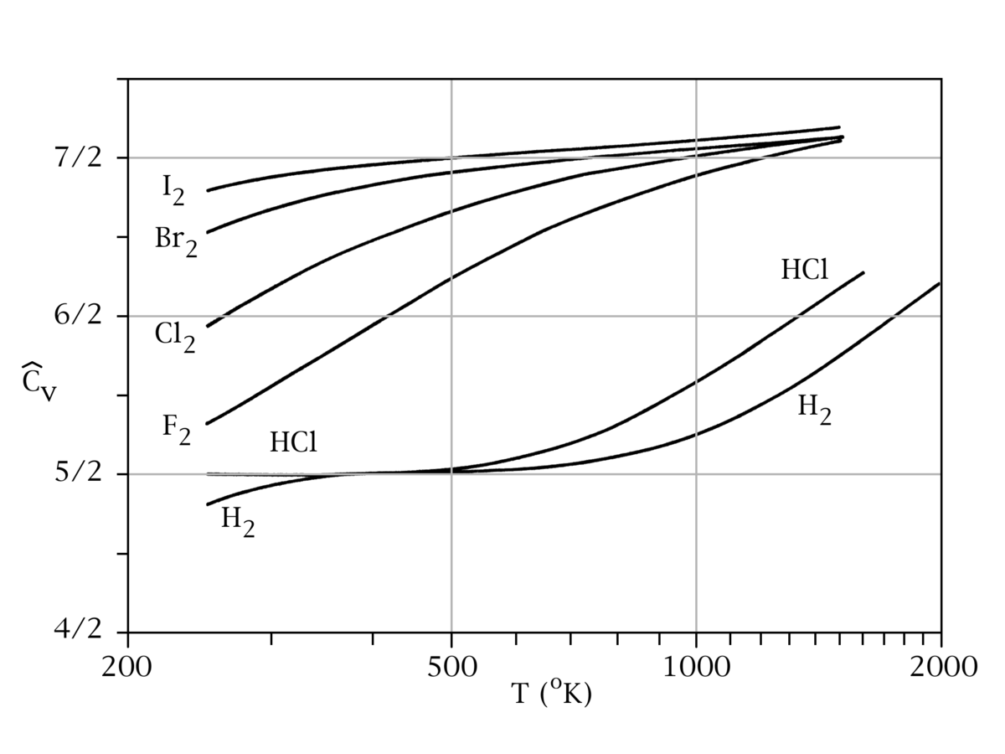
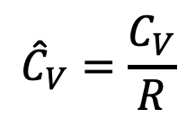
Why this trend going from $I_{2}$ down to $H_{2}$?
$${\hat{C}}_{V}=\frac{C_{V}}{R}$$

Slide 3
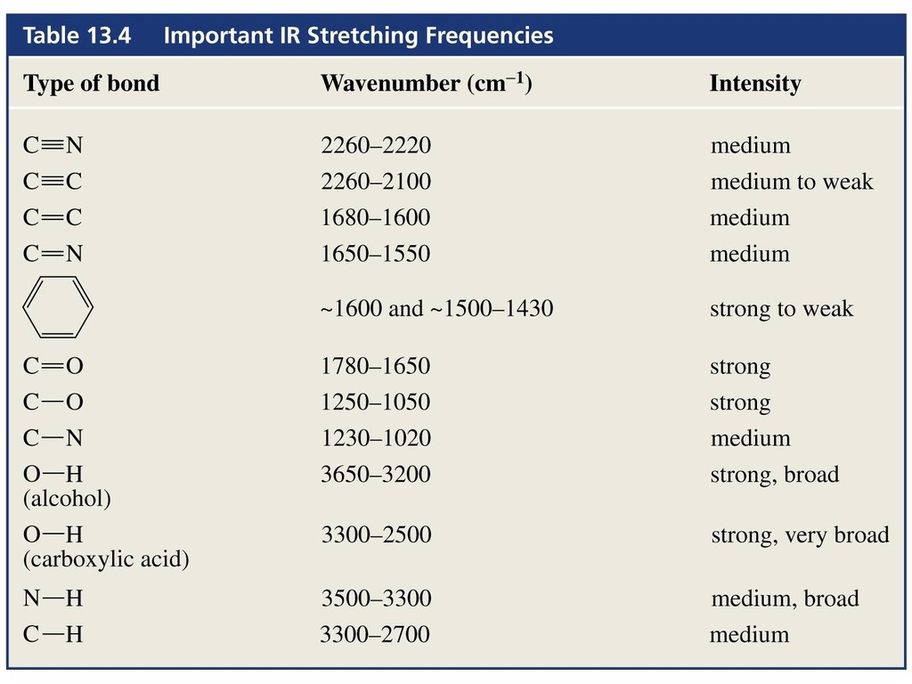
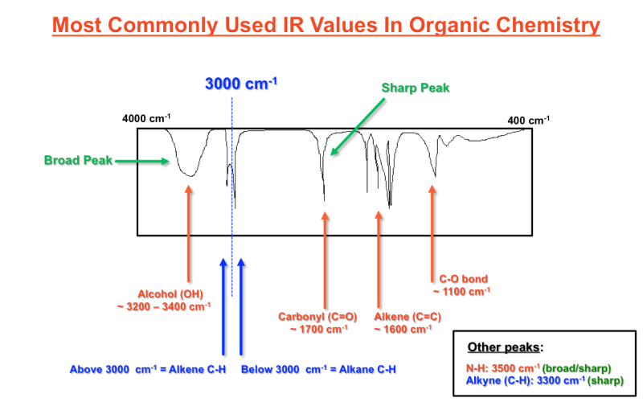
Why light molecules are more likely to have a larger T*

Slide 4

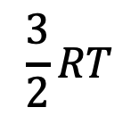


Temperature is high enough for $I_{2}$ to vibrate, but not the others
$$\frac{3}{2}RT$$
$$I_{2}$$
$$F_{2}$$
$$H_{2}$$

Slide 5
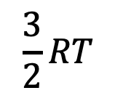
Temperature is high enough for $I_{2}$ and $F_{2}$to vibrate, but not $H_{2}$
$$\frac{3}{2}RT$$
$$I_{2}$$
$$F_{2}$$
$$H_{2}$$

Slide 6
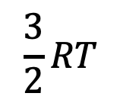
Temperature is high enough for all of them to vibrate
$$\frac{3}{2}RT$$
$$I_{2}$$
$$F_{2}$$
$$H_{2}$$

Slide 7
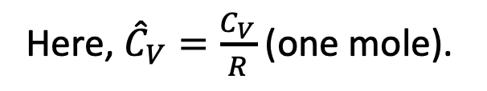
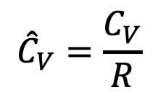
What heat capacities look like in real life (H₂)
Here, ${\hat{C}}_{V}=\frac{C_{V}}{R}$ (one mole).
$${\hat{C}}_{V}=\frac{C_{V}}{R}$$
At temperatures below 300 K, H₂ seems to be losing access to rotational motions as well! (Also a quantum effect).

Slide 8
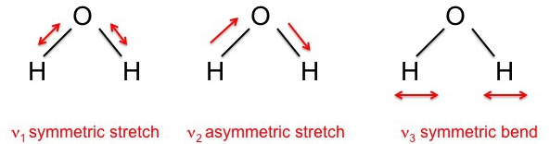
Polyatomic molecules actually have multiple vibrational modes
Example: H₂O has three vibrational modes
Molecules with more atoms have even more vibrational modes
At high temperature, all become active (each with their own characteristic $T^{∗}$)

Slide 9
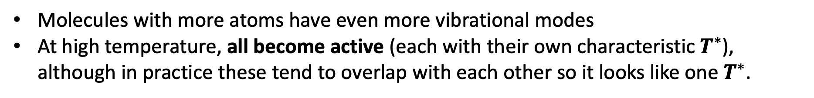
Polyatomic molecules actually have multiple vibrational modes
Example: H₂O has three vibrational modes
Molecules with more atoms have even more vibrational modes
At high temperature, all become active (each with their own characteristic $T^{∗}$), although in practice these tend to overlap with each other so it looks like one $T^{∗}$.

Slide 10
Let’s do a full analysis of water …
Write down C_{V} in the low-temperature limit
Write down C_{V} in the high-temperature limit
Putting T* at about the middle of your x-axis, sketch U(T) and C_{V} (T)

Slide 11
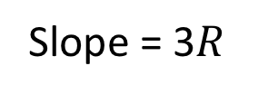
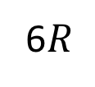
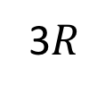
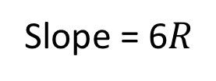
Let’s do a full analysis of water …
Write down C_{V} in the low-temperature limit
Write down C_{V} in the high-temperature limit
Putting T* at about the middle of your x-axis, sketch U(T) and C_{V} (T)
Slope = 6$R$
U(T)
Slope = 3$R$
(classical limit)
C_{V}(T)
6$R$
3$R$
T*
T

Slide 12
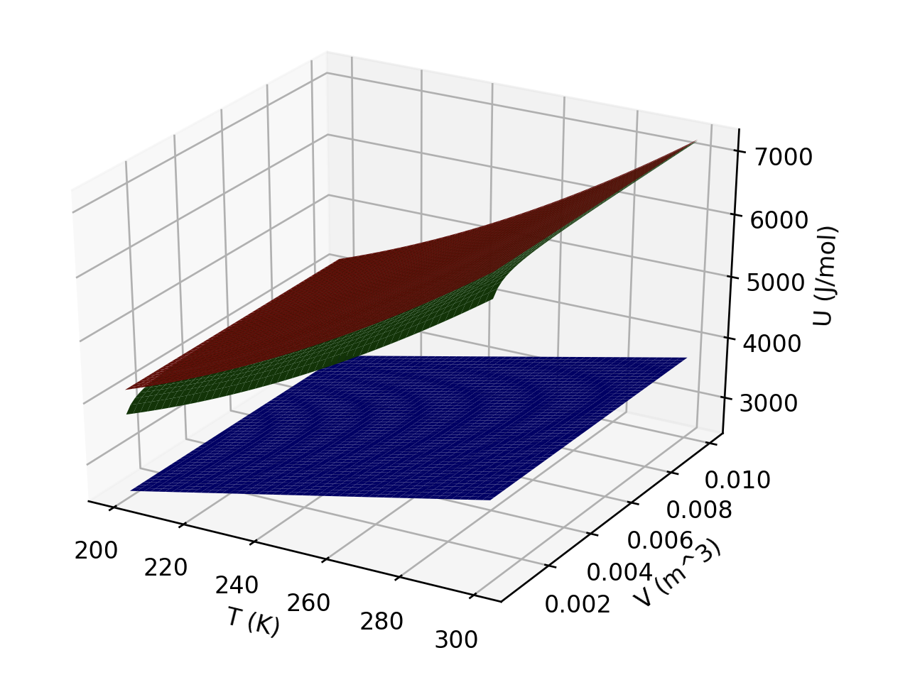
Back to U(T,V): here’s a more realistic picture, with three different gases
A little more realistic
U(T,V)
V
T
Three surfaces means we’re looking at three different gases.

Slide 13

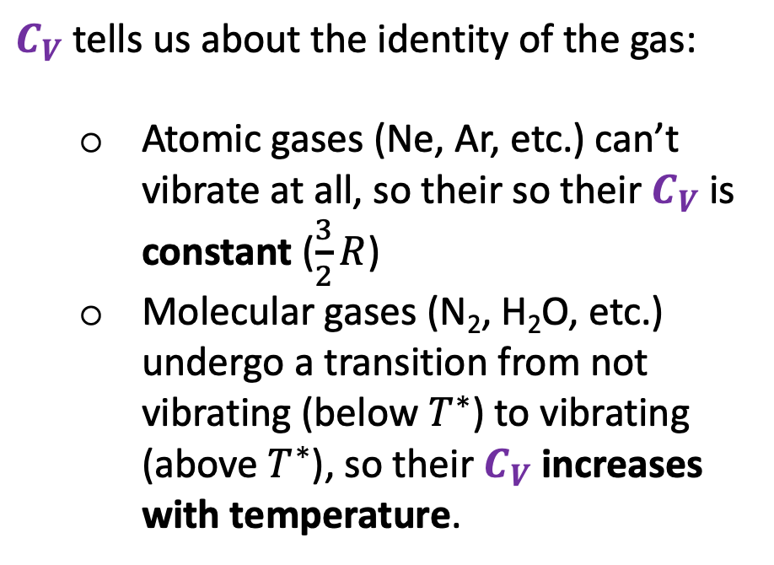
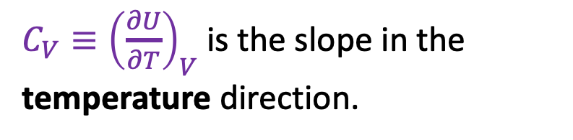
Interpreting U(T,V)
$C_{V}$ tells us about the identity of the gas:
Atomic gases (Ne, Ar, etc.) can’t vibrate at all, so their so their $C_{V}$ is constant ($\frac{3}{2}R$)
Molecular gases (N₂, H₂O, etc.) undergo a transition from not vibrating (below $T^{∗}$) to vibrating (above $T^{∗}$), so their $C_{V}$ increases with temperature.
${C_{V}≡\left(\frac{∂U}{∂T}\right)}_{V}$ is the slope in the temperature direction.

Slide 14
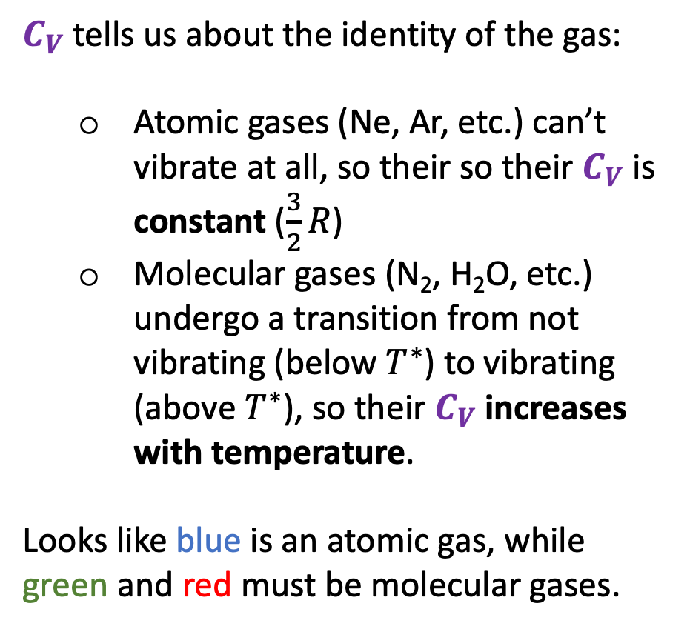
Interpreting U(T,V)
$C_{V}$ tells us about the identity of the gas:
Atomic gases (Ne, Ar, etc.) can’t vibrate at all, so their so their $C_{V}$ is constant ($\frac{3}{2}R$)
Molecular gases (N₂, H₂O, etc.) undergo a transition from not vibrating (below $T^{∗}$) to vibrating (above $T^{∗}$), so their $C_{V}$ increases with temperature.
Looks like blue is an atomic gas, while green and red must be molecular gases.
${C_{V}≡\left(\frac{∂U}{∂T}\right)}_{V}$ is the slope in the temperature direction.

Slide 15
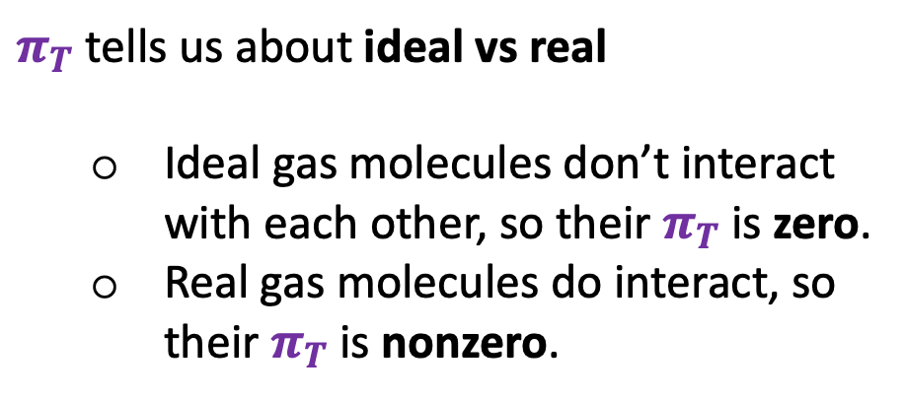
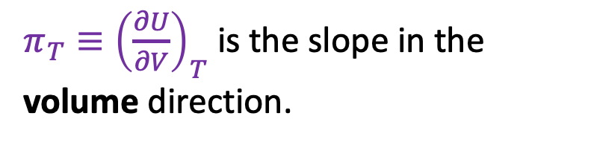
Interpreting U(T,V)
$π_{T}$ tells us about ideal vs real
Ideal gas molecules don’t interact with each other, so their $π_{T}$ is zero.
Real gas molecules do interact, so their $π_{T}$ is nonzero.
$π_{T}≡{\left(\frac{∂U}{∂V}\right)}_{T}$ is the slope in the volume direction.

Slide 16
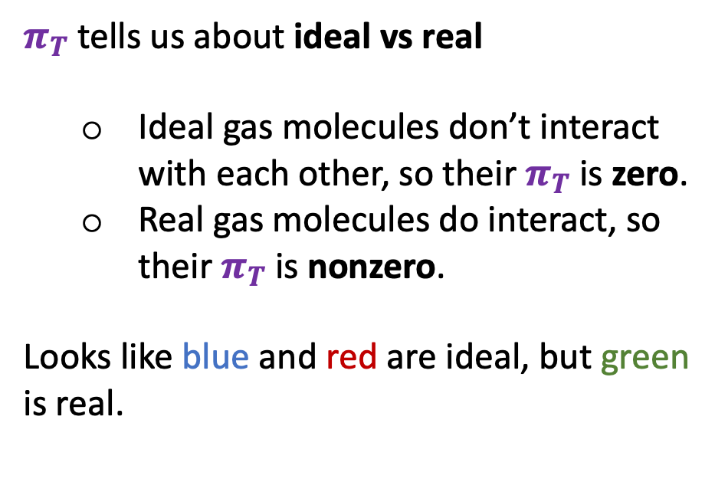
Interpreting U(T,V)
$π_{T}$ tells us about ideal vs real
Ideal gas molecules don’t interact with each other, so their $π_{T}$ is zero.
Real gas molecules do interact, so their $π_{T}$ is nonzero.
Looks like blue and red are ideal, but green is real.
$π_{T}≡{\left(\frac{∂U}{∂V}\right)}_{T}$ is the slope in the volume direction.

Slide 17
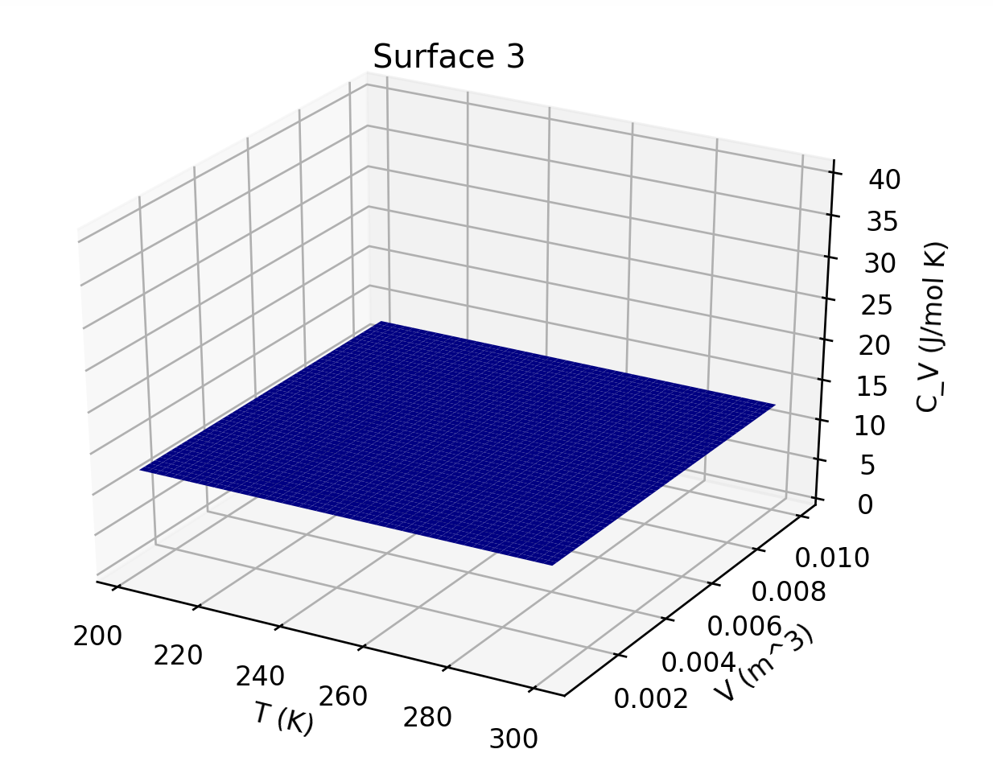
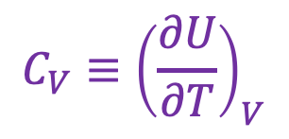
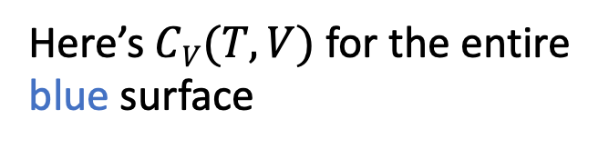
Interpreting U(T,V)
$${C_{V}≡\left(\frac{∂U}{∂T}\right)}_{V}$$
Here’s $CV(T,V)$ for the entire blue surface

Slide 18
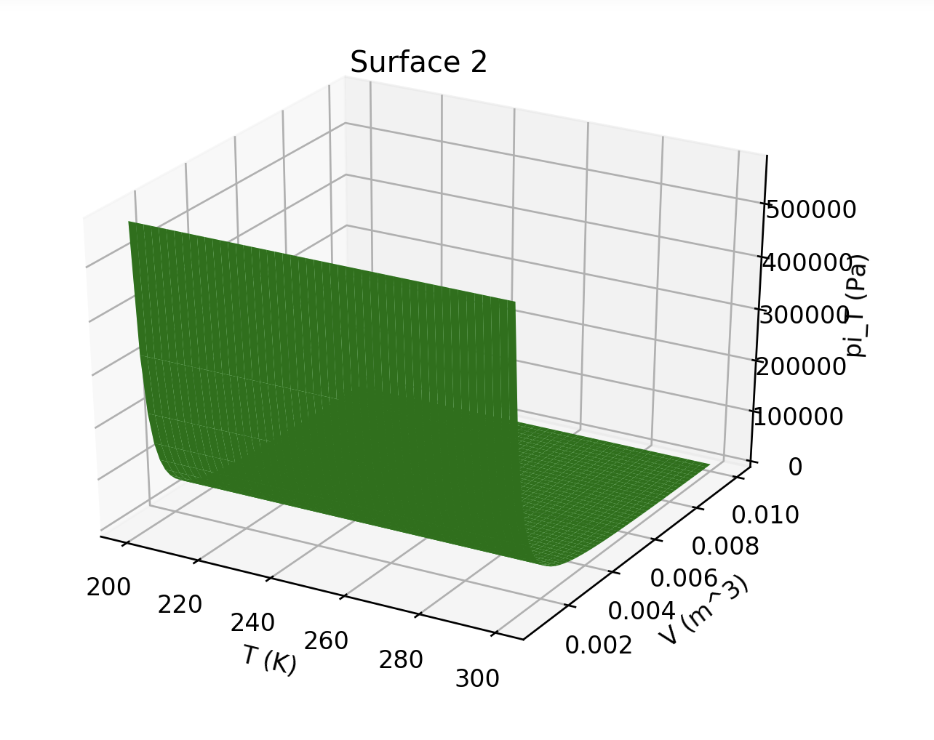
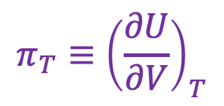

Interpreting U(T,V)
$$π_{T}≡{\left(\frac{∂U}{∂V}\right)}_{T}$$
Here’s $πV(T,V)$ for the green surface

Slide 19
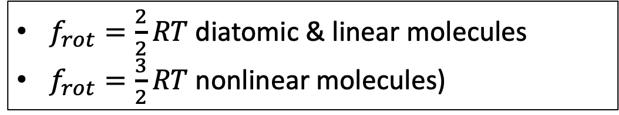
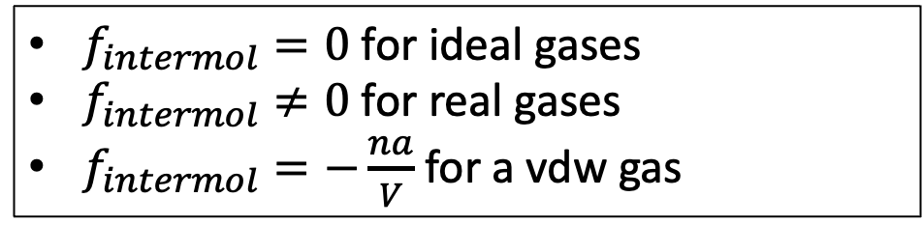
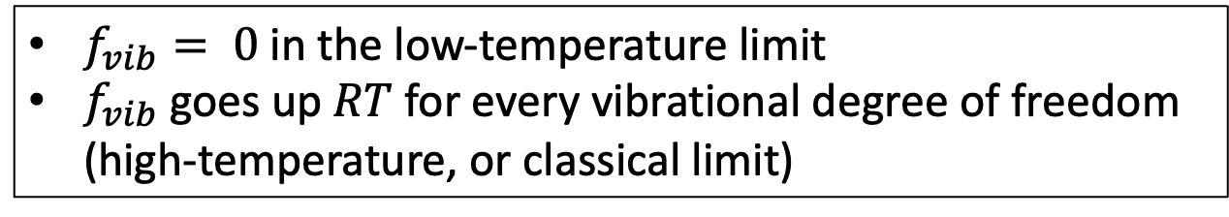
An analytical form for U(T,V)
Because three translational degrees of freedom
$$U\left(T,V\right)=\left[\frac{3}{2}RT+f_{rot}\left(T\right)+f_{vib}\left(T\right)+f_{intermol}(T,V)\right]× n$$
$f_{intermol}=0$ for ideal gases
$f_{intermol}≠0$ for real gases
$f_{intermol}=−\frac{na}{V}$ for a vdw gas
$f_{rot}=\frac{2}{2}RT$ diatomic & linear molecules
$f_{rot}=\frac{3}{2}RT$ nonlinear molecules)
$f_{vib}= 0$in the low-temperature limit
$f_{vib}$goes up $RT$for every vibrational degree of freedom (high-temperature, or classical limit)

Slide 20
Why U goes up with increasing volume at a given temperature (for a real/vdw gas)
Intermolecular attractions

Slide 21
Why U goes up with increasing volume at a given temperature (for a real/vdw gas)
Intermolecular attractions

